Slide 1

Transport Safety Awareness Training for Suppliers
According DSM Life Saving Rules and associated Transport Safety Standard
Version A: May 2022

Slide 2
Transport Safety Awareness Training for Suppliers
According DSM Life Saving Rules and associated Transport Safety Standard
1 | Why is Transport Safety important? & What’s in it for you as Supplier?
2 | DSM Life Saving Rules ⇨ DSM Transport Safety Requirements
3 | Load Securing
4 | Safe loading & unloading
5 | Dangerous Goods Transport

Slide 3
1. Why is Transport Safety important?
& What’s in it for you as Supplier?

Slide 4
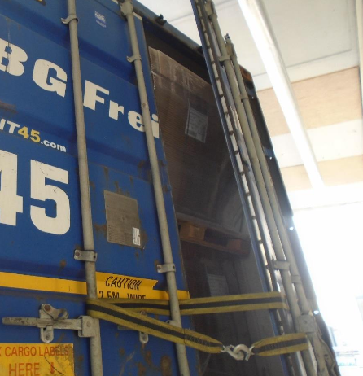
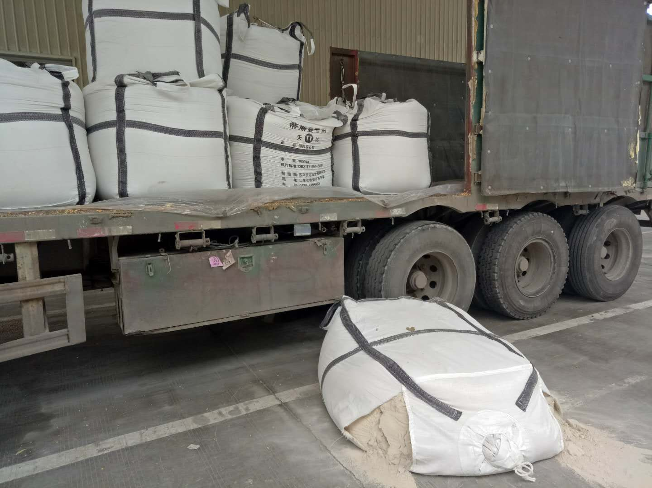
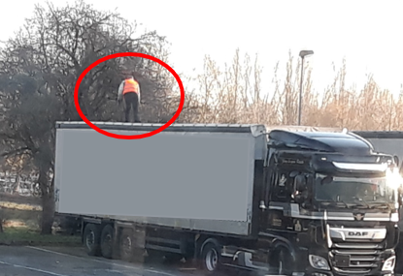
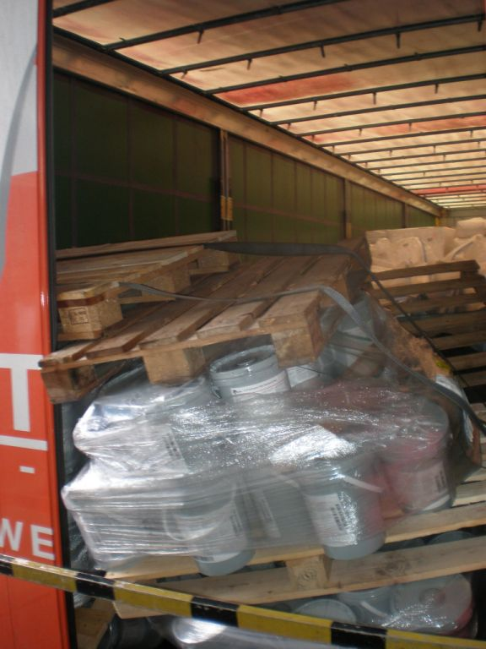
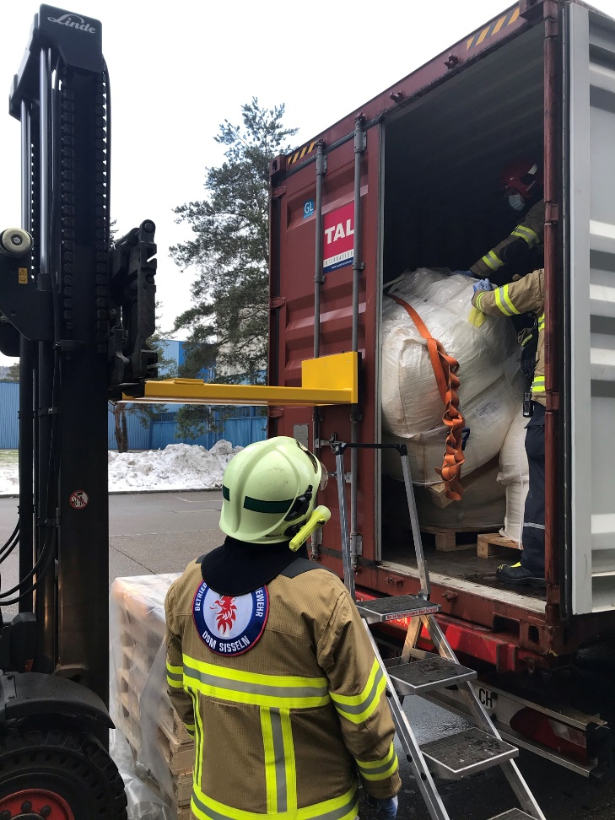
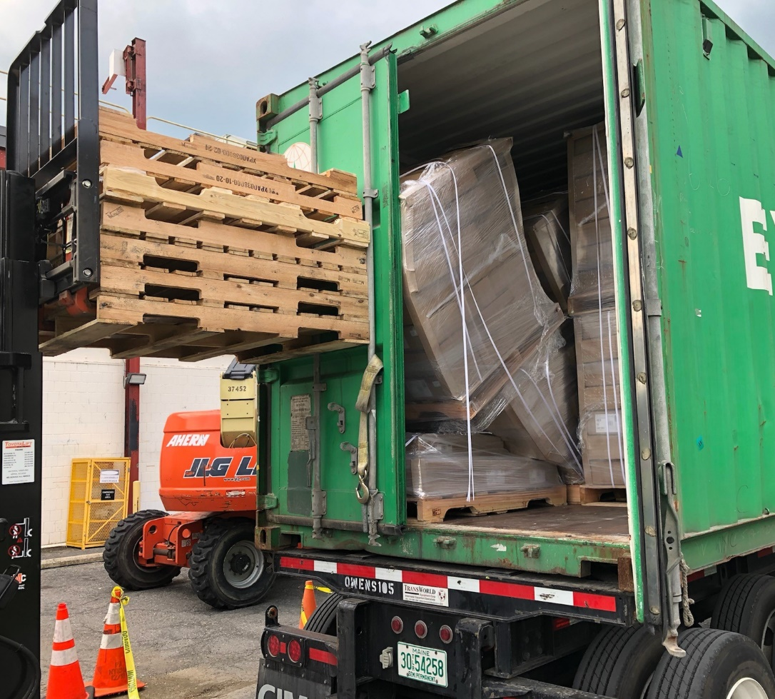
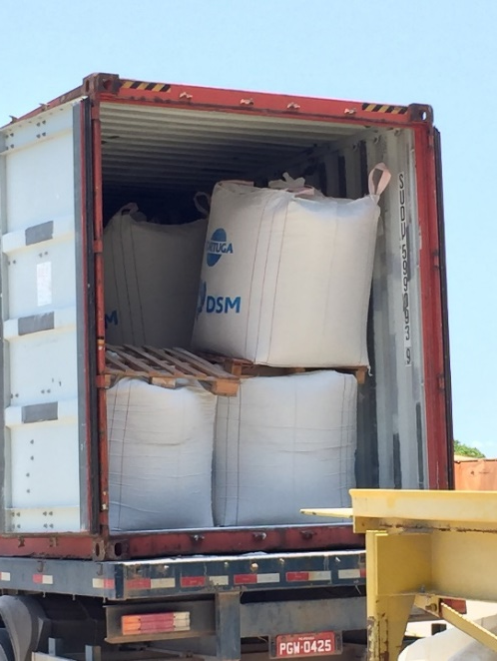
1. Why is Transport Safety important?
DSM pictures!!!

Slide 5

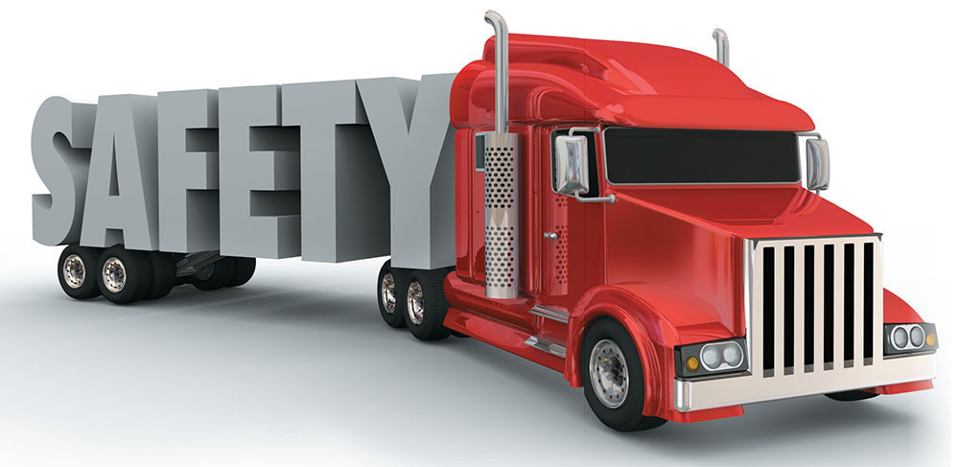
& What’s in it for you as supplier?
Safer operations for both supplier, carrier, DSM including contractors and ultimately our customers
Smooth operations
Less disruptions in supply chain
  (e.g. no re-packing, damage & spill prevention)
Preventing incidents, complaints, claims

Slide 6
2. DSM Life Saving Rules
DSM Transport Safety Requirements

Slide 7
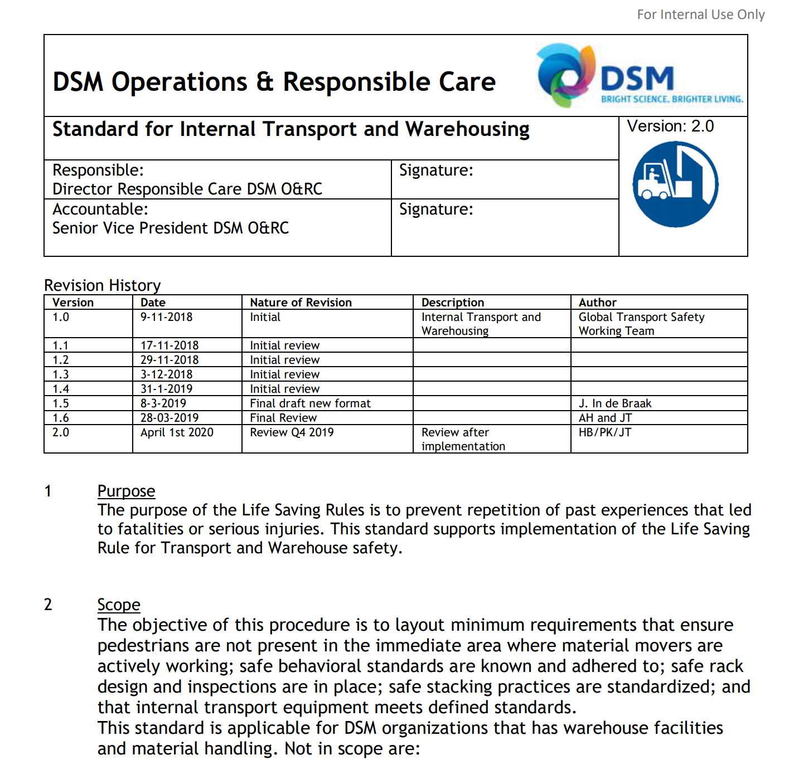

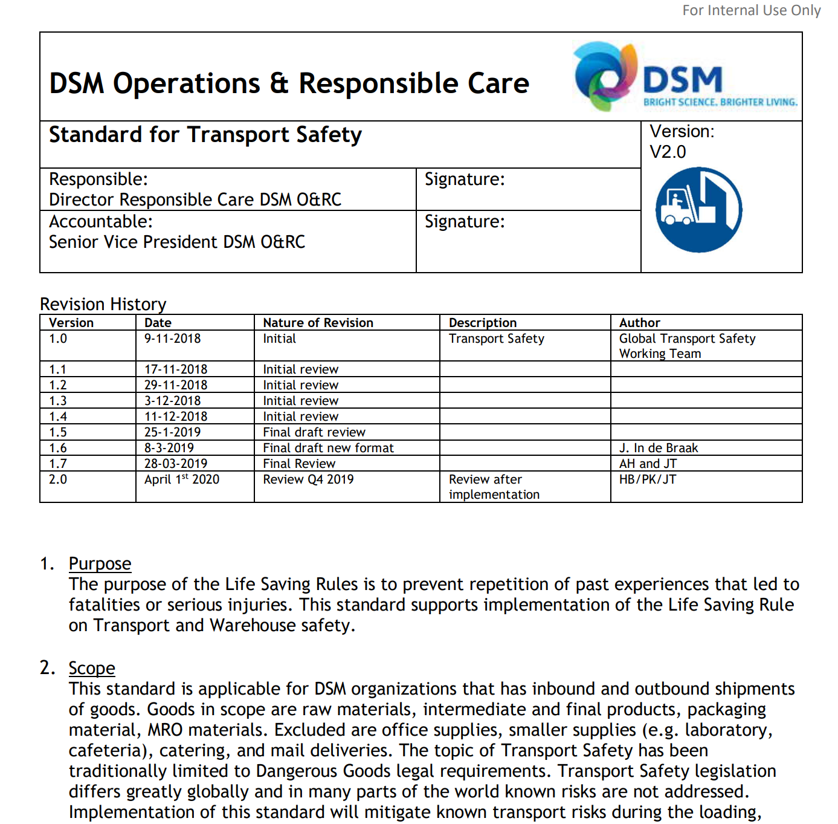
2. DSM Life Saving Rules
DSM Transport Safety Requirements
Transport and Warehouse Safety

Slide 8
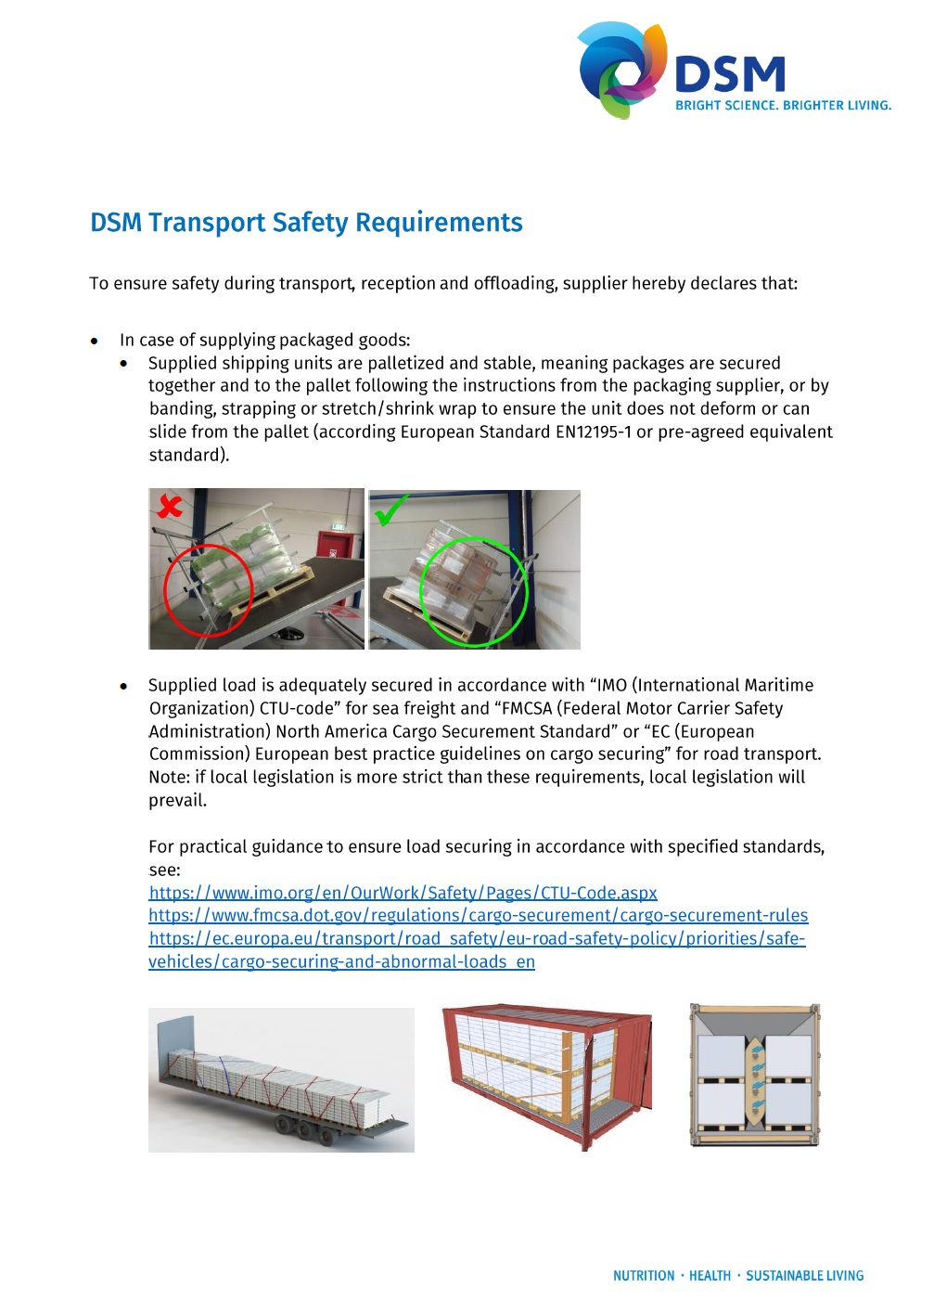
2. DSM Life Saving Rules
DSM Transport Safety Requirements
Multi-language ‘DSM Transport Safety Requirements’ defined as annex to supplier agreements, includes key elements of Life Saving Rules on Transport Safety:
Ensure stability of shipping unit
Apply load securing against unwanted movements
Keep people out of the hazard zone when opening containers or trucks
Safety towards truck drivers entering a DSM site to deliver or pickup packaged or bulk goods

Slide 9
3. Load Securing

Slide 10

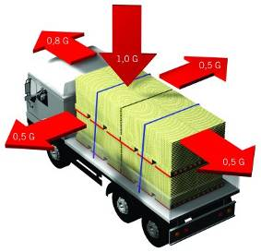
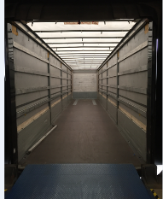
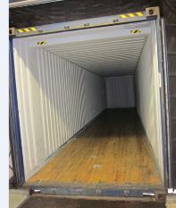
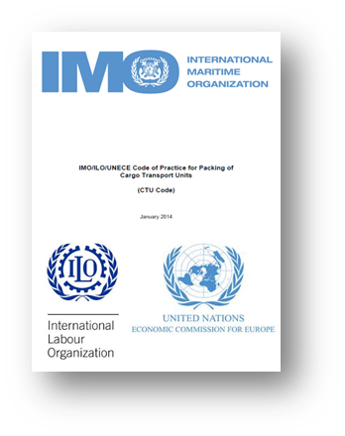
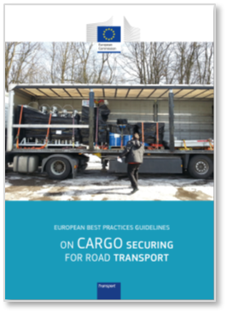
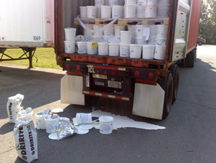
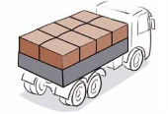

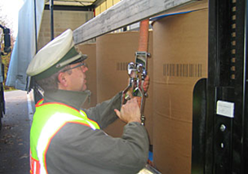
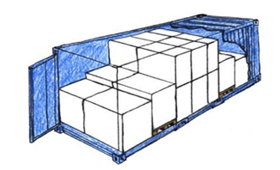
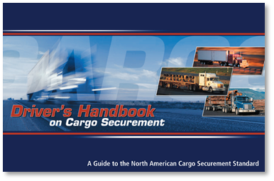
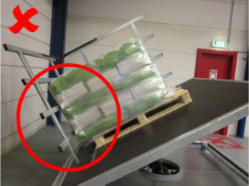

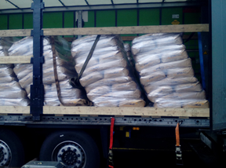
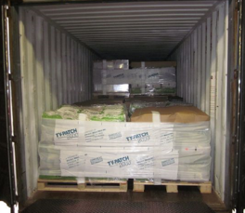

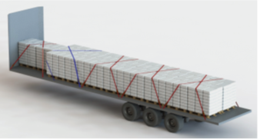
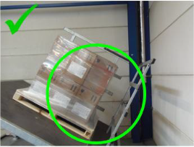


3. Load Securing
Basics: Six steps to achieve a secured load
1. Understand reasons
Safety
2. Understand basics
G-forces
6. Review & monitor
Changing legislations
3. Ensure stability shipping unit
4. Transport mode
5. Implementation
Quality
Compliancy
Operational
Responsibilities
Shipper:
Carrier:
Stable shipping unit
Enabler
Equipment
Executer
Securing method
Create stable shipping unit
Pre-loading check
“Form-fit” Loading
Blocking and bracing
Additional load securing
Post-loading check
Effectiveness check
Road (LTL/FTL)
Sea (LCL/FCL)
Multi-modal
NA Cargo Securement Standard
IMO CTU-Code
Palletized
Instructions packaging supplier or by
Banding or by
Strapping or by
Stretch/shrink wrapping
EU Best Practice Guidelines on Cargo Securing
Local legislation
Packages secured together and to pallet, in line with pallet dimensions following:
Apply standard /practical guidance depending transport mode
All above

Slide 11
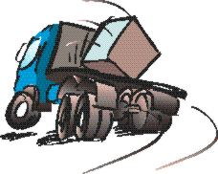
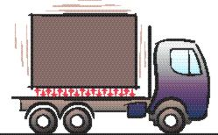
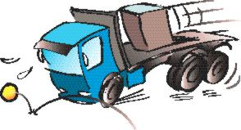
3. Load Securing
Implementation: Main principle
  The cargo must be positioned (blocked) in such a condition, and when necessary additional lashing actions must be taken, that during normal transport, the goods can not endanger any person.
  ⇨ Normal Transport includes:
Emergency Brake Manoeuvre Bad Road Conditions

Slide 12
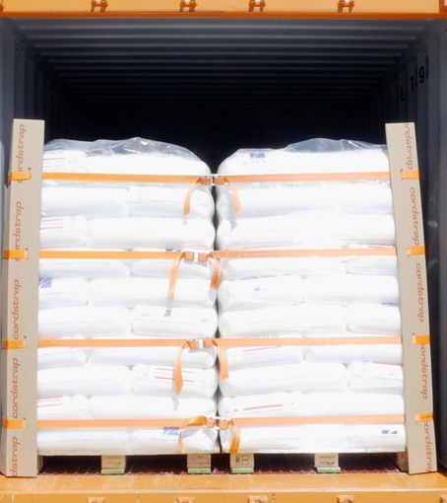

3. Load Securing
Implementation: Main steps
      5 Steps:
Pre-loading visual check
“Form-fit” Loading
Blocking and bracing
Additional load securing
Post-loading check

Slide 13


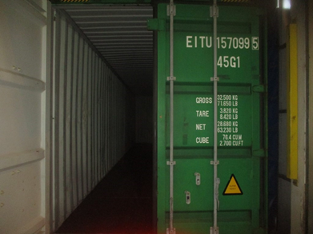
3. Load Securing
Implementation: Step 1. Pre-loading visual check
Registration
Tire condition of trailer
Lights
Operation of the doors
Damaged or missing floor or side boards
No sharp objects that could damage packaging
No roof damage
Dry and clean
Availability and condition of load securing fixtures

Slide 14

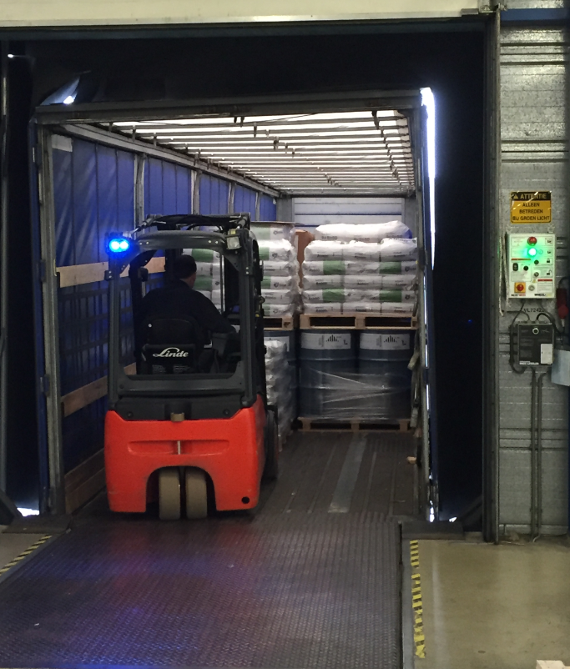
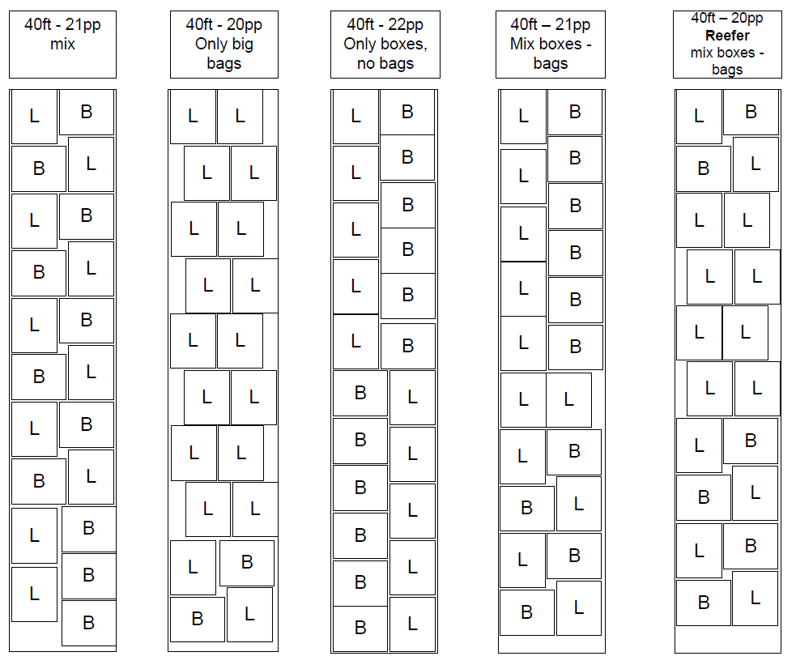
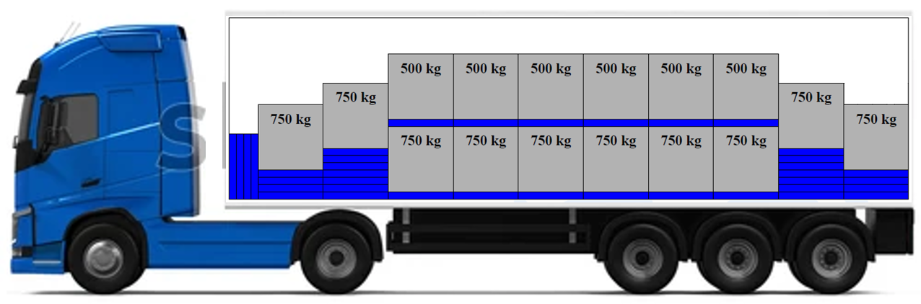
3. Load Securing
Implementation: Step 2. “Form-fit” loading
Minimize voids / form-fit loading
In accordance with loading plan

Slide 15

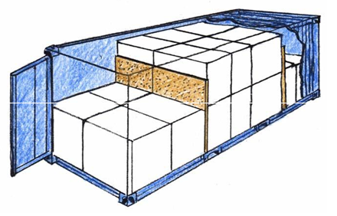
3. Load Securing
Implementation: Step 3. Blocking and bracing
Threshold blocking
Panel blocking
Threshold blocking Panel blocking

Slide 16
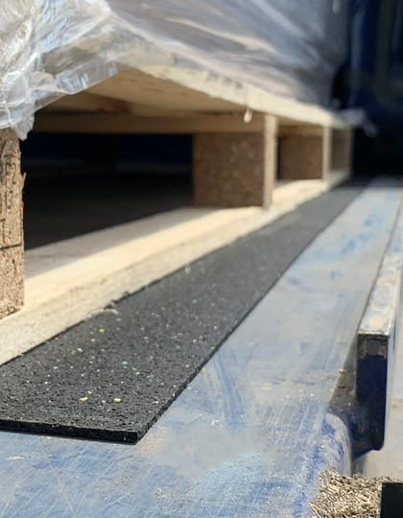
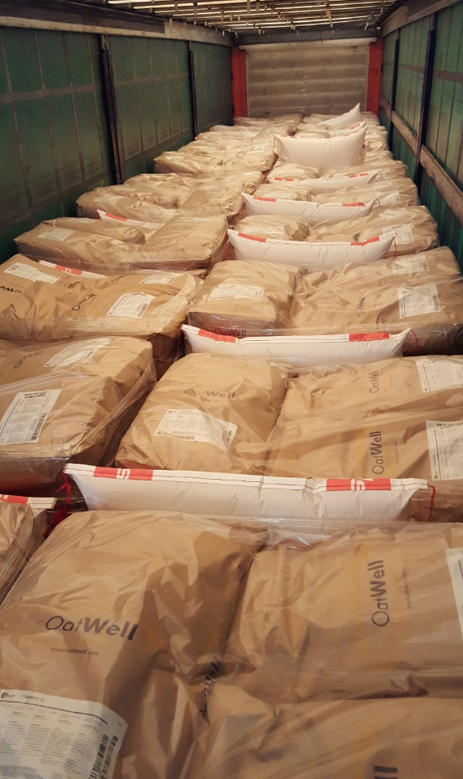
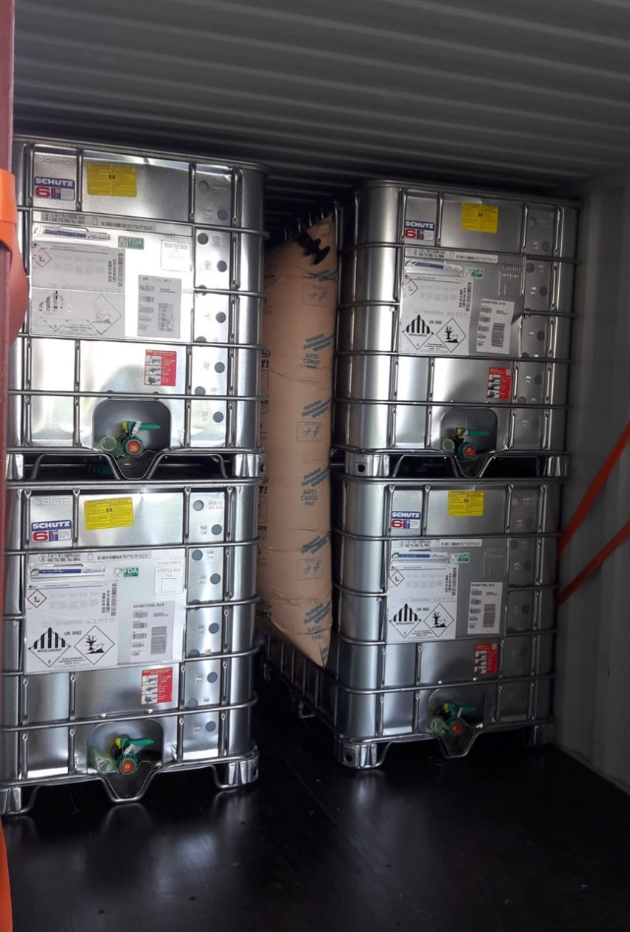
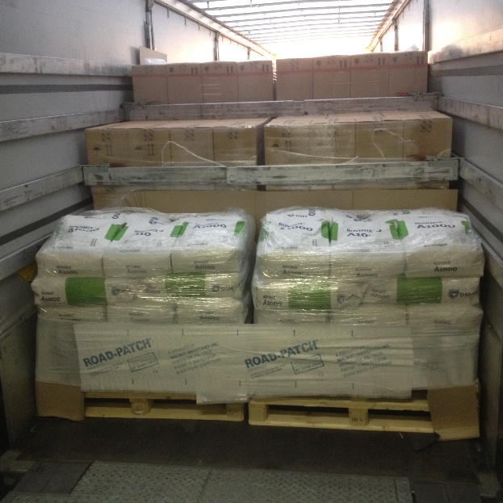
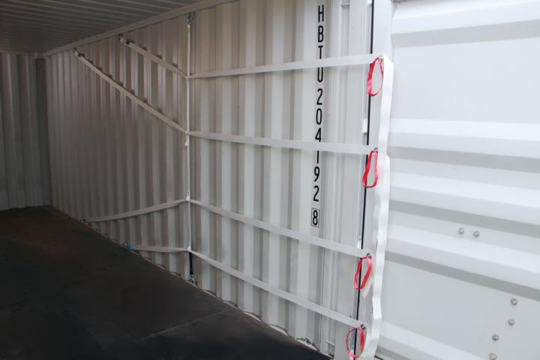
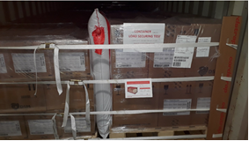
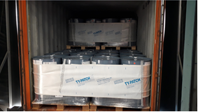
3. Load Securing
Implementation: Step 4. Additional load securing
Use of Load Securing Devices
  Lashing systems
  Dunnage bags
  Anti-slip material

Slide 17

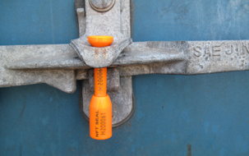
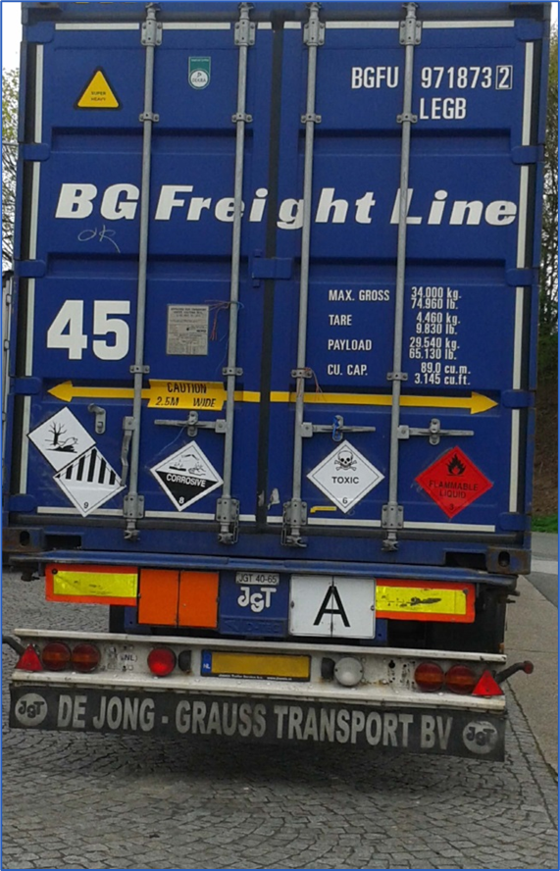
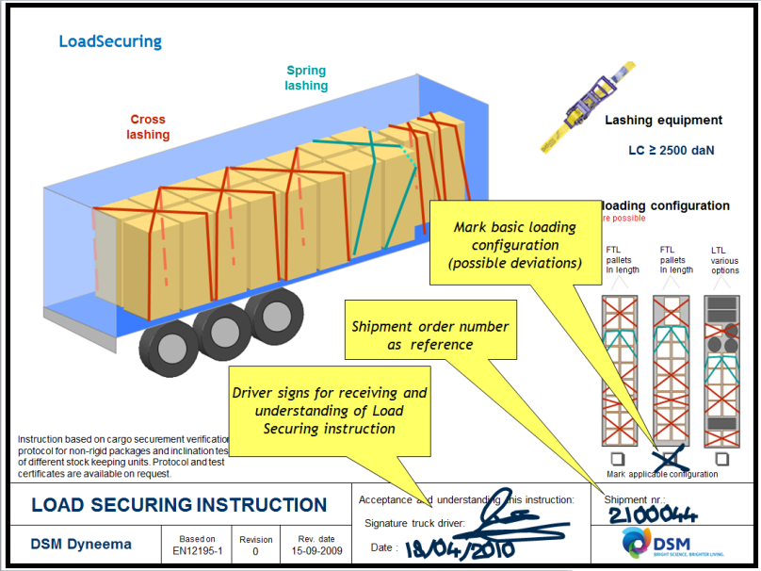
3. Load Securing
Implementation: Step 5. Post loading check
Identification of trailer/container and driver
Load distribution according to loading plan
Segregation requirements met
Load properly secured (blocking and bracing and additional methods)
Placards in place (if applicable)
Photograph(s) taken
Doors closed
Doors sealed (if applicable)

Slide 18
3. Load Securing
DSM Life Saving Rules compliance
For practical guidance to ensure load securing in accordance with DSM standards, see:
IMO/ILO/UNECE Code of Practice for Packing of Cargo Transport Units (CTU Code)
Cargo Securement Rules based on North American Cargo Securement Standard
European Best Practices Guidelines on Cargo Securing for Road Transport

Slide 19
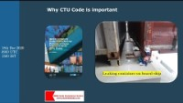
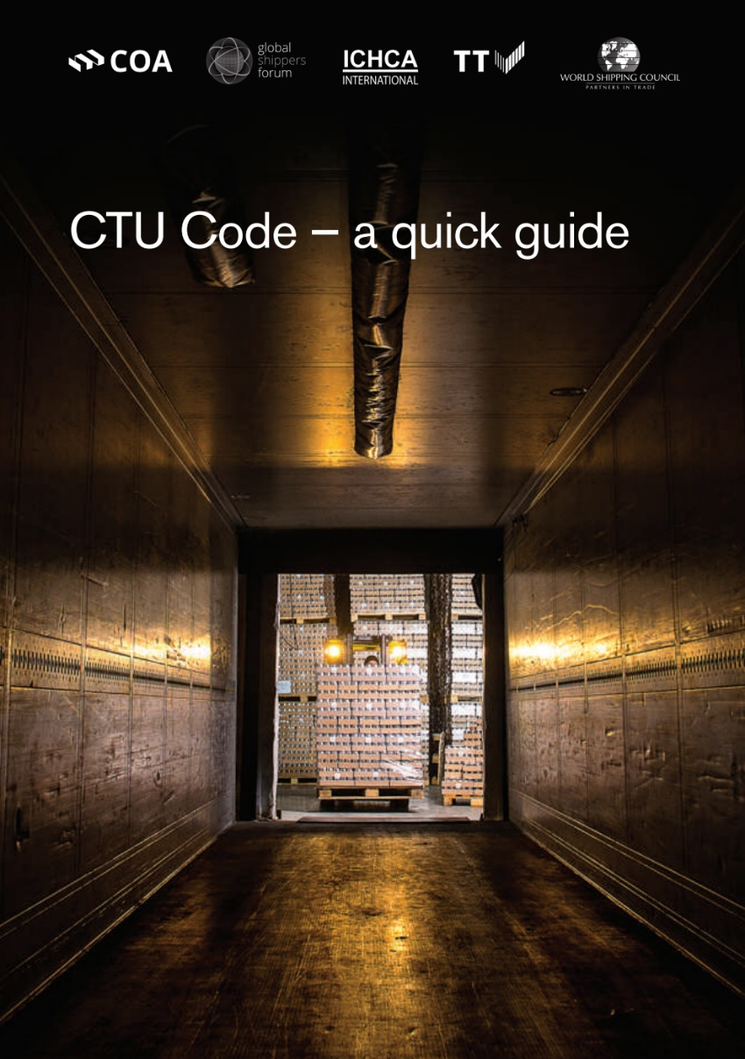
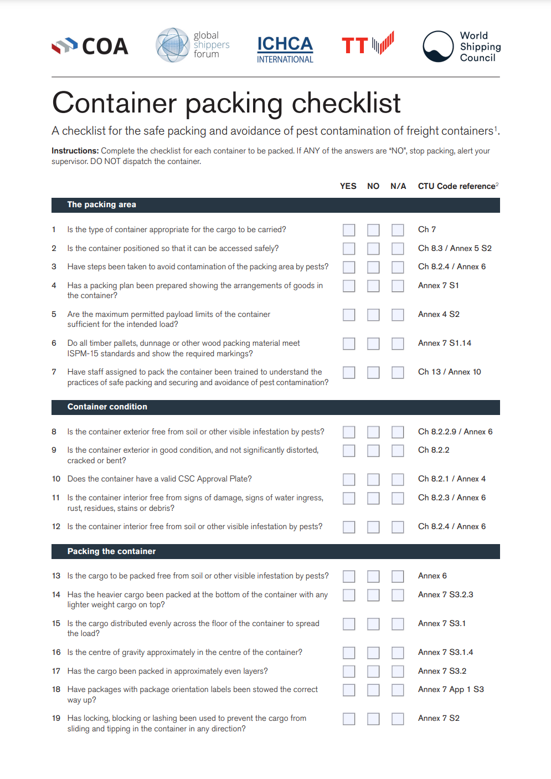
3. Load Securing
DSM Life Saving Rules compliance
Free online webinar and supporting practices on CTU Code basics:

Slide 20
4. Safe loading & unloading

Slide 21
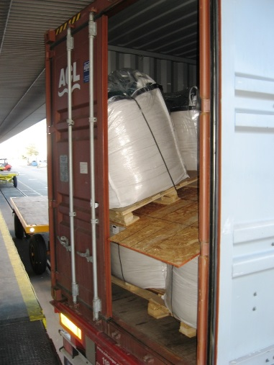
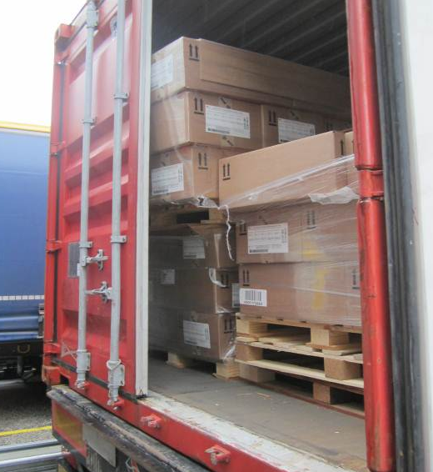






4. Safe loading & unloading
Keep people out of the hazard zone when opening containers or trucks
✗
✓

Slide 22









4. Safe loading & unloading
Secure the truck against movement after final positioning
✗
✓

Slide 23







4. Safe loading & unloading
Safety Requirements for truck drivers
Suppliers ensure that truck drivers entering the site to deliver or pick-up goods:
Are capable of effectively communicating the SHE relevant aspects with site personnel in accepted language(s)
Are qualified to drive and transport the concerned goods
Comply with:
  Site traffic and Personal Protective Equipment (PPE) rules
  Relevant Life Saving Rules for drivers (drive safely, no drugs or alcohol, no smoking, observe working at heights requirements)
  Instructions to wait for authorized site personnel before opening sides/doors of containers, trailers or opening hatches of tank trucks and tank containers
  Follow site instructions to open and secure the truck for (un)loading
✗

Slide 24
5. Dangerous Goods Transport

Slide 25





Regulations
Dangerous Goods (DG) / Hazardous Materials (Hazmat)
Dangerous goods are substances, mixtures, articles, machinery… presenting a risk for people, property or the environment
They are classified on the basis of immediate physical or chemical effects.
Dangerous goods include not only toxic or explosive chemicals, but also biological substances or everyday articles that we might not immediately consider to be dangerous.
UN 1327 Straw
Notes:
But let’s have a look what Dangerous Goods are:

Slide 26

Dangerous Goods Regulations
Classification – Classes, Divisions, Packing Groups
Class 1: Explosives (易爆品)
Class 2: Gases (易燃气体)
Class 3: Flammable Liquids (易燃液体)
Class 4: Flamable solids (其他易燃)
Class 5: Oxidizing substances and Organic Peroxides (氧化物及有机过氧化物)
Class 6: Toxics / Infectious Substances (有毒/感染物)
Class 7: Radioactive Material (放射物)
Class 8: Corrosive Substances (腐蚀物)
Class 9: Miscellaneous (杂项)
Notes:
These substances, mixtures and articles are assigned to 9 classes.

Slide 27


Dangerous Goods Regulations
Classification – Classes, Divisions, Packing Groups
Identification
Dangerous Goods are uniquely identified by two pieces of information:
      the four-digit UN Number
      the corresponding Proper Shipping Name
                e.g. UN 1170 Ethanol
                UN 1993 Flammable liquid, n.o.s.*
Safety Data Sheet – Section 14
Packing Groups:
    the degree of danger is given by so-called Packing Groups
    I = high, II = medium, III = low
Notes:
And are identified by the UN-number and a corresponding Proper Shipping Name.
Important is also the so-called Packing Group because that gives a hint to the degree of danger.
This information can be found (in case of chemicals) in Chapter 14 of the SDS.

Slide 28

Dangerous Goods Regulations
Packaging
UN packaging code
Important:
  Dangerous Goods may only be transported in packaging which are certified to UN standards.
  The packages shall be marked with a UN packaging specification which must be shown on the surface of the package
  Special instructions of the packaging certificate (e.g. closure, inner packaging, etc.) to be followed
4G/Y145/S/83 NL/VL823
Notes:
As I said, having identified the UN number this has consequences on the packaging we are allowed to use.
These must have passed certain tests and if it’s been successful, a packaging certificate is signed by the authorities and a certain code is printed on the outside of the packaging.

Slide 29

Dangerous Goods Regulations
Bulk container/vessels
Important:
  DG transport in bulk is only allowed if it is indicated in the central table of DG Regulation by:
  a Tank Code (e.g. LGBF) or
  a Tank Instruction (e.g. T10, for portable tanks)
Notes:
For bulk transport, there are similar requriements. For each UN-number a certain Tank code and tank instruction is given. If not indicated, transport in tanks or tank container is not possible.

Slide 30

Dangerous Goods Regulations
Transport document
DG information shall be shown in the following order:
  UN-Number
  Proper Shipping Name (Technical name, if need)
  primary hazard class (subsidiary hazard)
  Packing Group
  Additional information to be added (e.g. Flashpoint) if required
Examples:
UN 1230 Methanol, 3 (6.1), II
UN 1251 Methylvinylketone, stabilized, 6.1 (3,8), I (-7°C c.c.) Marine Pollutant
UN 2810 Toxic liquid, organic, n.o.s. (cholecalciferol), 6.1, II
Notes:
Backup - hidden

Slide 31

Dangerous Goods Regulations
High Consequence Dangerous Goods - Security
  High Consequence Dangerous Goods (HCDG) have the potential for misuse in a terrorist event and may produce serious consequences such as casualties or mass destruction
  Measures must be taken to minimize theft or misuse e.g. hand-over only after having checked the right for delivery/receipt
  Carriers, consignors and other participants (including infrastructure managers) engaged in the transport of HCDG shall adopt, implement and comply with a security plan (UN 1.4.3.2.2.1)
Notes:
And last but not least Security aspect must be taken into account.
Following the events of September 11th 2001 several measures regarding the security of goods transportation have been developed and implemented
It was recognized that some of these goods can be misused in a terrorist event. So measures must be taken to minimize the risk.
According to the regulations a Security Plan must be in place at the supplier, carrier etc. (incl customer).

